Slide 1


ENGOO · XIAOHONGSHU | WEEKLY SOCIAL PERFORMANCE
Year of the Snake Lift-Off
Reporting week: Jan 27 – Feb 2, 2025
Chinese New Year campaign drives the strongest week since tracking began

Slide 2
Executive Summary
1
Best week since tracking began
3,063 views · +50% WoW
2
New followers more than doubled
+47 new · +147% WoW
3
Engagement rate hit 5.5%
Saves +67% · Comments +75%
4
Profile visits climbed
175 profile visits · +36% WoW
★
Takeaway
Momentum is real — watch the post-holiday dip.

Slide 3
KPI Scorecard
Views
New Followers
Engagement Rate
3,063
47
5.5%
▲ +50%
▲ +147%
▲ +0.4pp
Saves
Comments
Watch Time
40
14
22 hrs
▲ +67%
▲ +75%
▲ +46%
Week of Jan 27 – Feb 2, 2025 vs Jan 20 – 26, 2025

Slide 4

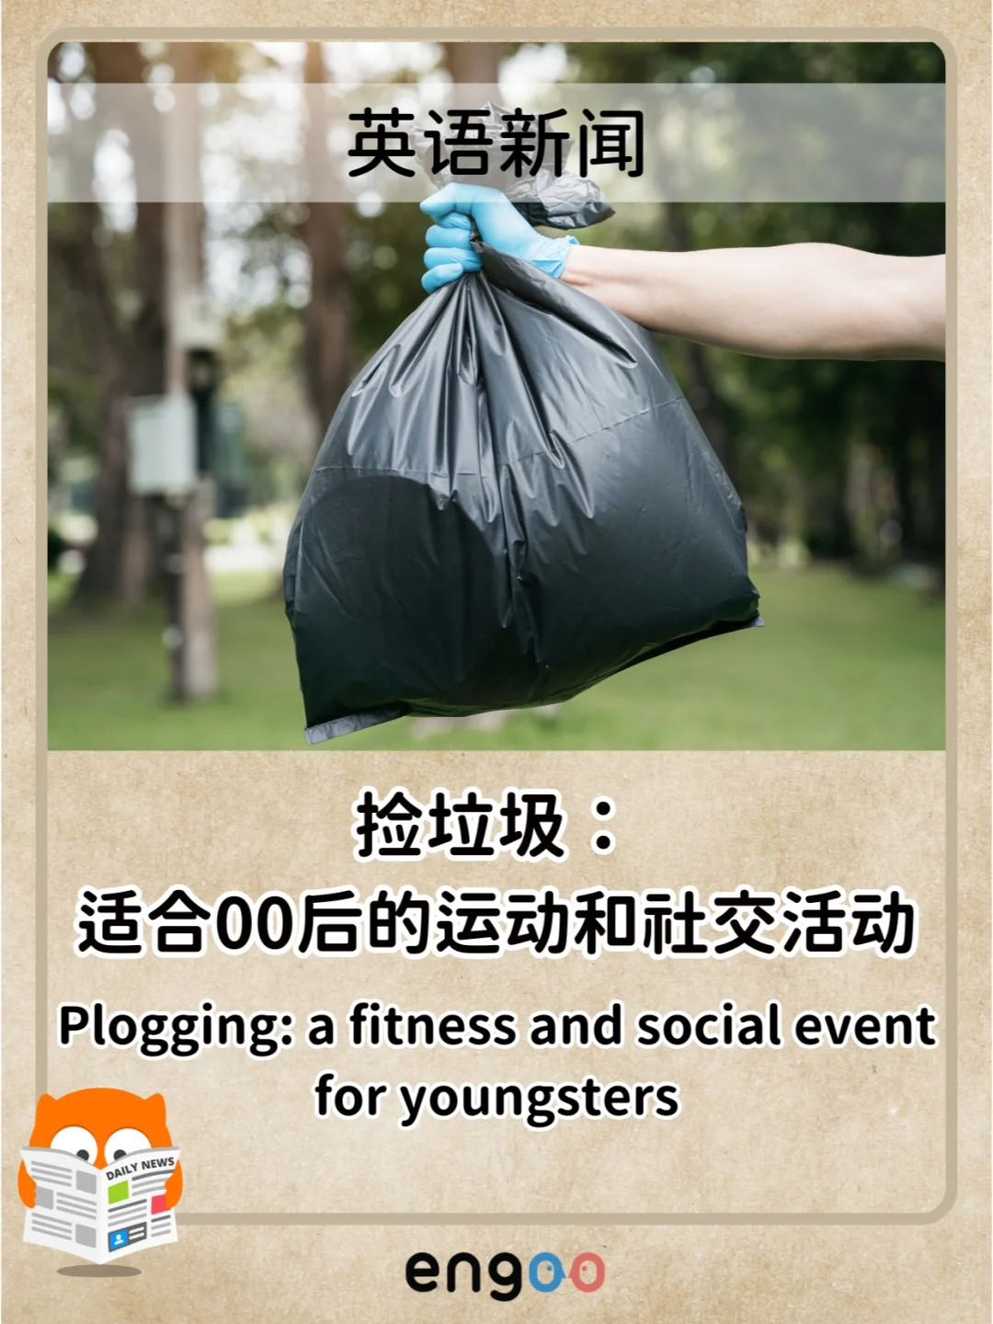

Content Highlights
Lunar New Year Zodiac
Bilingual News
Festival Word Games
Fortune rankings + lucky colors
Daily news that doubles as study material
Bilingual riddles for the Lantern Festival

Slide 5
What Drove the Week
Cultural timing won
WORKED
Saves grew faster than likes
WORKED
Posting the Zodiac content on the actual CNY dates put us in front of a surging, intent-driven audience.
40 saves (+67%, vs +59% for likes) means viewers bookmarked posts as study references — high-value, repeat-view behavior.
Followers compounded
WORKED
Watch the post-holiday dip
WATCH
+47 new followers (+147%): the holiday series converted browsers into subscribers.
Sunday (Feb 2) views fell to 210 as the holiday wound down. Expect normalization next week without a new hook.

Slide 6
Recommendations
1
Build a cultural-calendar content engine
Pre-produce bilingual posts for Lantern, Qingming, May Day
2
Lean into “save-worthy” formats
One reference carousel per week — rankings, riddles, glossaries
3
Convert the follower spike
Pin a “start here” post + free-trial CTA while interest is warm
4
Reply to every comment within 24h
Comments +75% — sustained replies signal the algorithm

Slide 7
Next Week — Action Plan
Action | Owner | Timing | Success Metric
Pre-build Lantern Festival riddle carousel | Content | Mon–Tue | Publish on festival day
Pin “start here” welcome post + trial CTA | Social | Mon | Profile-visit → trial clicks
Daily bilingual news post (study-ready) | Content | Daily | Hold save rate ≥ 1.3%
Reply to all comments within 24h | Community | Daily | 100% reply rate
Test 1 slang/glossary reference post | Content | Thu | Beat avg saves (5.7/day)
One owner per action · Review outcomes at next weekly sync

